Slide 1
Can AI help with classification of multiple eye diseases?
Shuaiheng Xiao
Department of Electrical and Computer Engineering
Stevens Institute of Technology

Slide 2
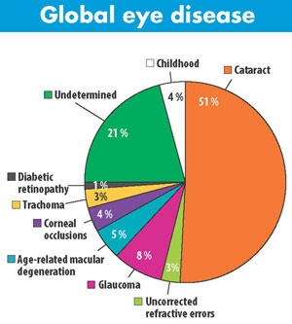
Did you know
Millions of people suffer from multiple eye diseases, including Diabetic Retinopathy(DR), Glaucoma, Cataract, Age related Macular Degeneration, Hypertension and Pathological Myopia.
Each year in the United States, diabetic retinopathy accounts for 12% of all new cases of blindness. It is also the leading cause of blindness in people aged 20 to 64.
Glaucoma affects about 2 million people in the United States. Worldwide, glaucoma is the second-leading cause of blindness after cataracts. Cataracts caused 51% of blindness in 2010, while caused 8%.
Blindness from cataracts occurs in about 10 to 40 per 100,000 children in the developing world, and 1 to 4 per 100,000 children in the developed world.

Slide 3
Dataset Description
The dataset is from Kaggle Ocular Disease Recognition https://www.kaggle.com/andrewmvd/ocular-disease-recognition-odir5k
This dataset is meant to represent ‘‘real-life’’ set of patient information collected by Shanggong Medical Technology Co., Ltd. from different hospitals/medical centers in China. In these institutions, fundus images are captured by various cameras in the market, such as Canon, Zeiss and Kowa, resulting into varied image resolutions.
This is a structured ophthalmic database of 5,000 patients with age, color fundus photographs from left and right eyes and doctors' diagnostic keywords from doctors.
Annotations were labeled by trained human readers with quality control management. They classify patient into seven labels including: Normal (N), Diabetes (D), Glaucoma (G), Cataract (C), Age related Macular Degeneration (A), Hypertension (H) and Pathological Myopia (M).

Slide 4
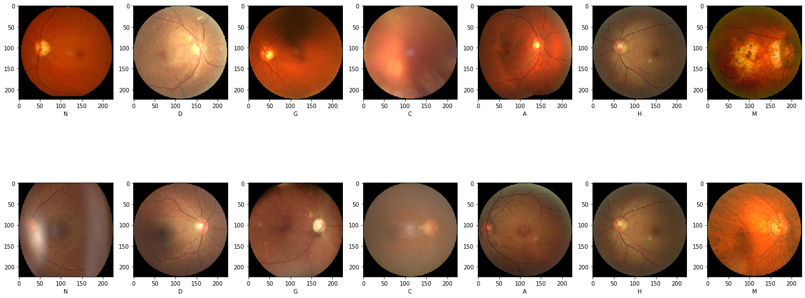
Dataset Description
Here are some images from dataset:

Slide 5
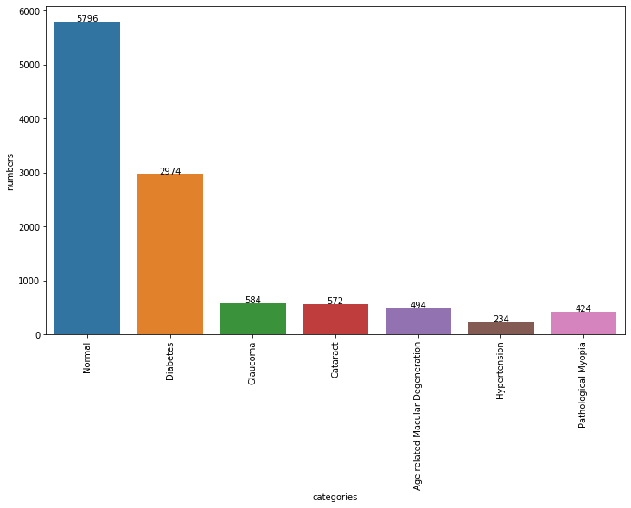
Dataset Description
We have 11078 images in total, but numbers of each classes have big difference.

Slide 6
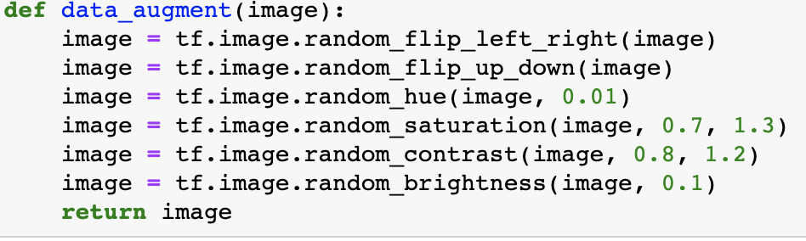
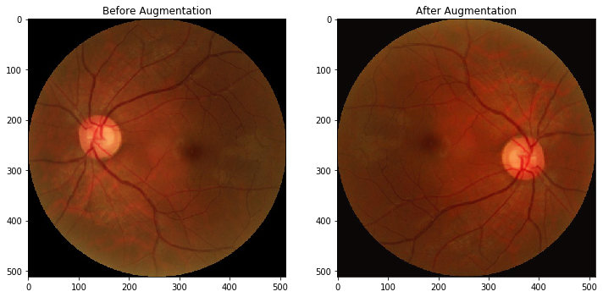
Preprocessing
Because images of some classes are way less than others, data augmentation algorithm is needed here.
We first randomly flip images with some angles, then adjust the hue and saturation of RGB images by a random factor. After that, we change the contrast and the brightness of images randomly.

Slide 7
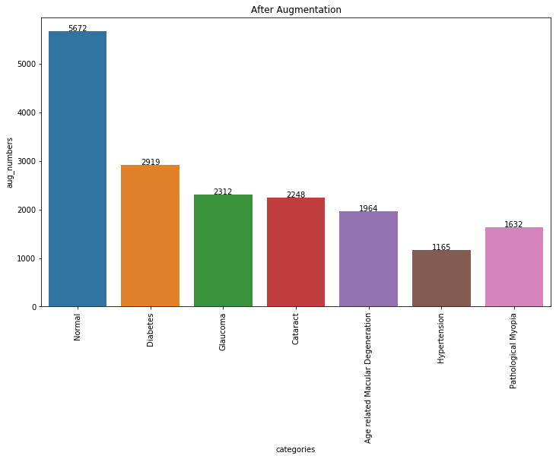
Preprocessing
After augmentation, we have 17912 images:

Slide 8
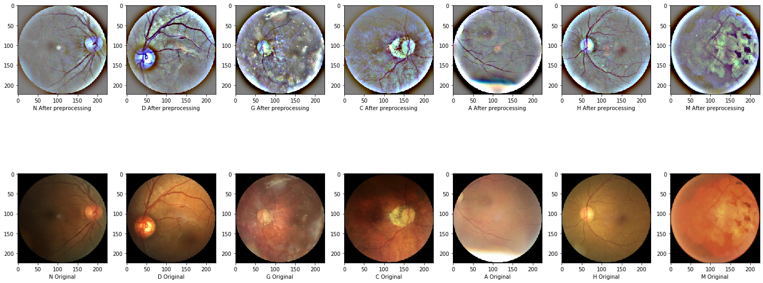
Preprocessing
Some features in images are not all that obvious, even machine can hardly detect them, which would significantly lower model accuracy. Therefore, Gaussian Blur could be implemented here as preprocessing.

Slide 9
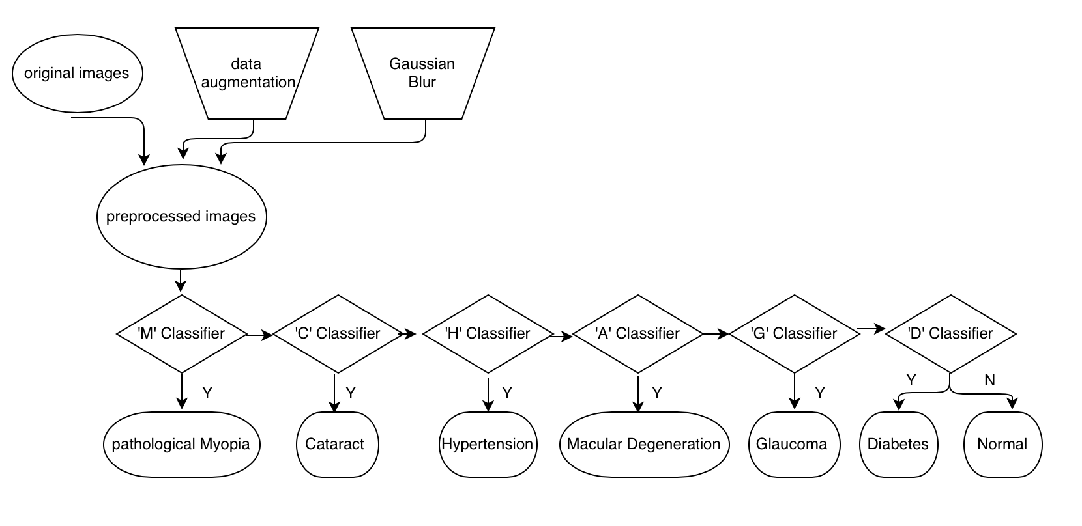
Method implementation
Design a series of models to classify multiple classes. Here is my preliminary plan.
Inputs
Models
Outputs

Slide 10

Method Implementation
Why VGG19?
Lots of medical detection models obtain nice performance by implementing VGG19, since it has appropriate layers, not too deep and not too shallow. Meanwhile, weights of VGG19 are open source, people do not need to train initial weights from random numbers. Therefore, I chose VGG19 as my primary neural network.

Slide 11
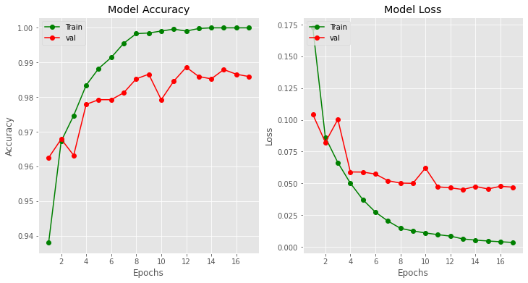
Preliminary Results
Split dataset with 0.7, 0.2, 0.1 as training set, validation set, testing set, respectively.
M detection model accuracy: 0.9817

Slide 12
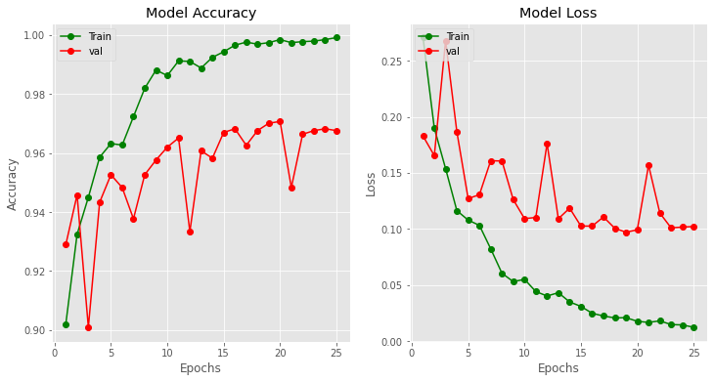
Preliminary Results
C detection model accuracy: 0.9733

Slide 13
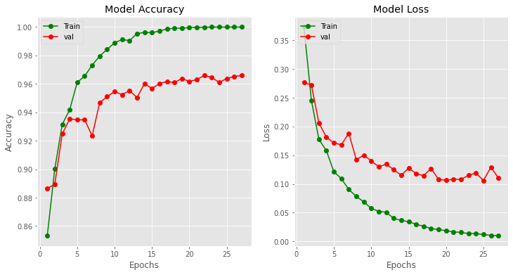
Preliminary Results
H detection model accuracy: 0.9623

Slide 14
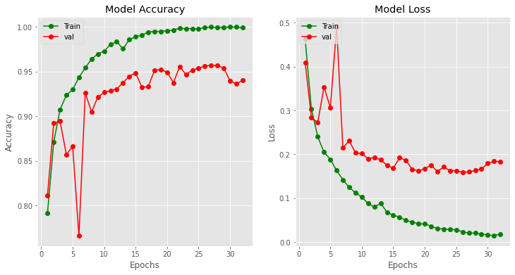
Preliminary Results
A detection model accuracy: 0.9498

Slide 15
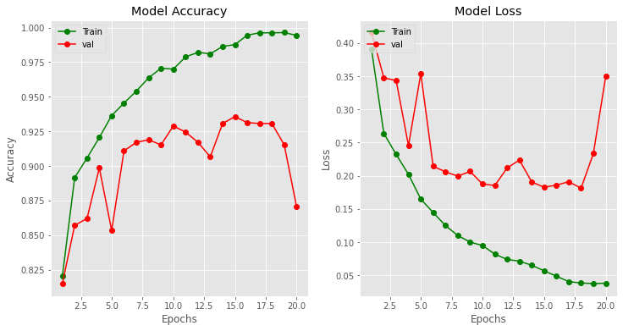
Preliminary Results
G detection model accuracy: 0.9231

Slide 16
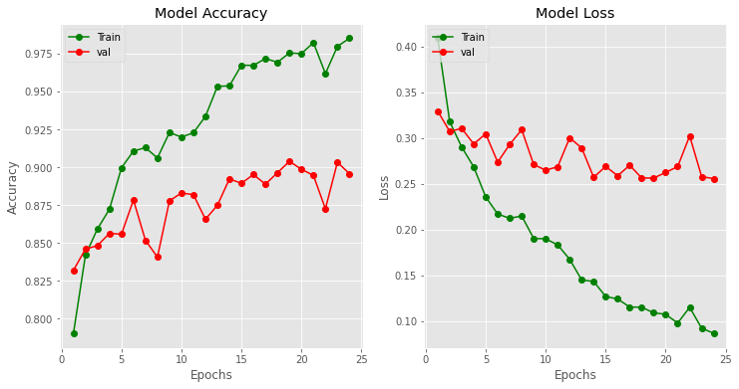
Preliminary Results
D detection model accuracy: 0.904286

Slide 17
Preliminary Results
The whole series model accuracy: 0.834286, where I tested 700 images and the model correctly predict 584 images.
The whole series model accuracy for predicting ‘N’ class is 0.57
The whole series model accuracy for predicting ‘D’ class is 0.84
The whole series model accuracy for predicting ‘G’ class is 0.88
The whole series model accuracy for predicting ‘C’ class is 0.91
The whole series model accuracy for predicting ‘A’ class is 0.84
The whole series model accuracy for predicting ‘H’ class is 0.85
The whole series model accuracy for predicting ‘M’ class is 0.95

Slide 18
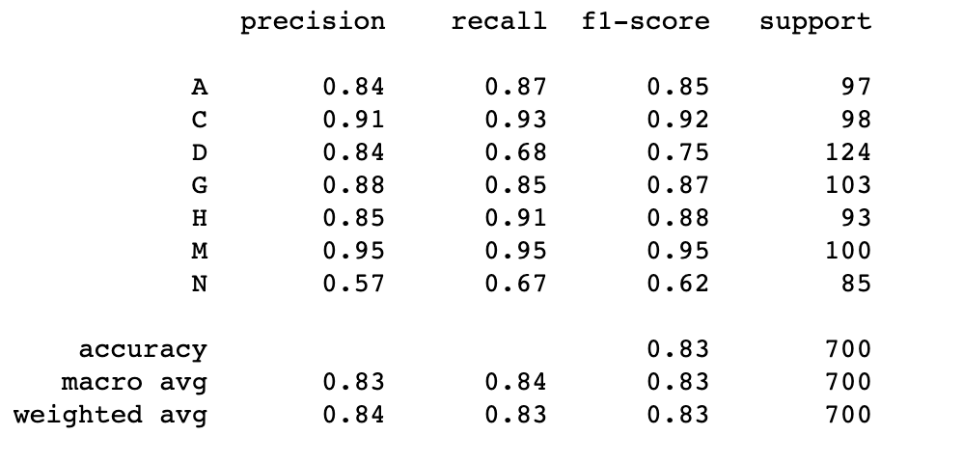
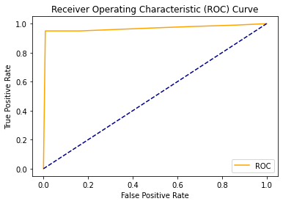
Preliminary Results

Slide 19
Future Plan
Instead of Binary classifier, try to implement multi-output classifier.
Implement other algorithms such as SVM.
Implement Weighted Majority Vote with different classifiers results
Do more data analysis and have better understanding with the dataset itself.

Slide 20
Shuaiheng Xiao
sxiao5@stevens.edu
(201)565-6541

